Slide 1
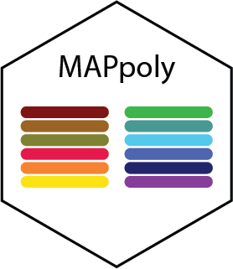
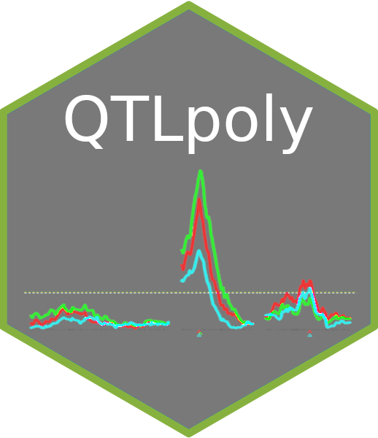

MAPpoly and QTLpoly: interconnected sweetpotato families
Marcelo Mollinari
Gabriel Gesteira
Guilherme Pereira
Bode Olukolu
Craig Yencho
Zhao-Bang Zeng

Slide 2
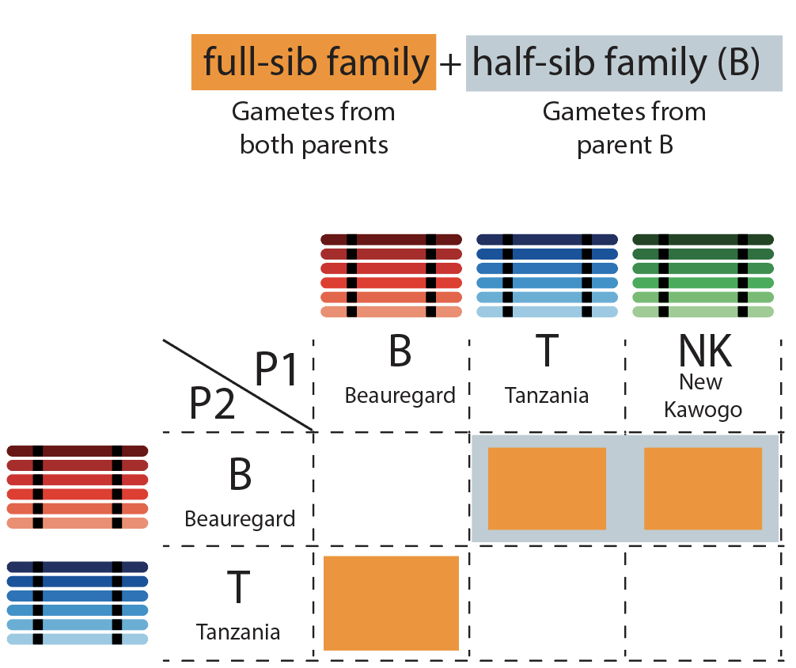
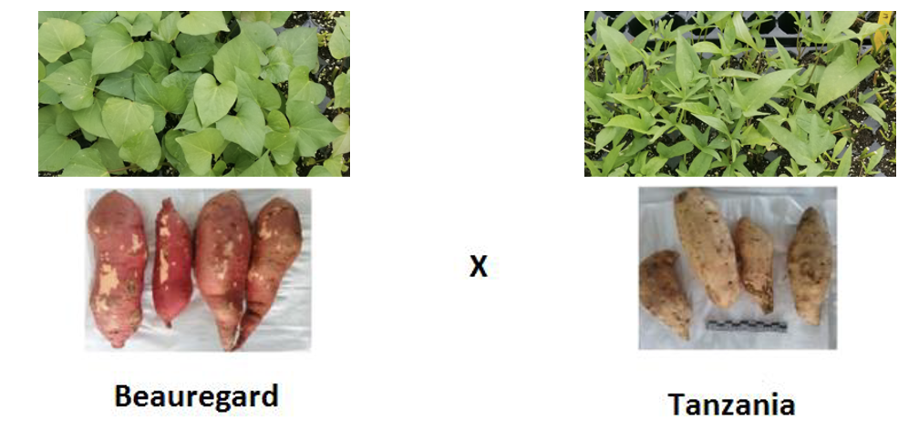
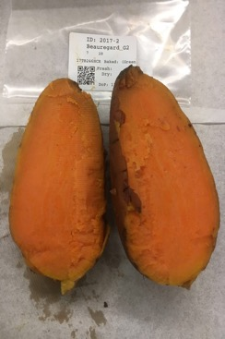
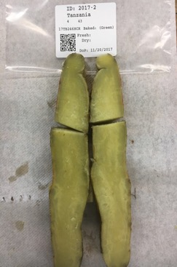
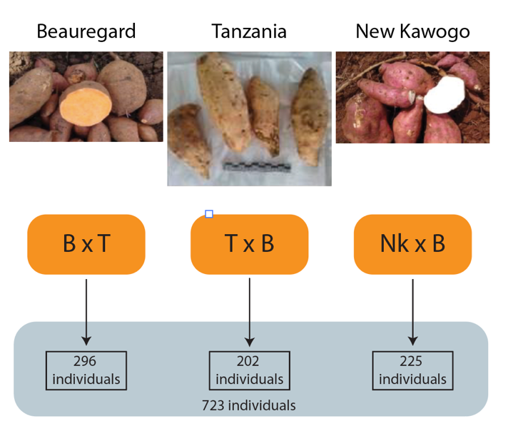
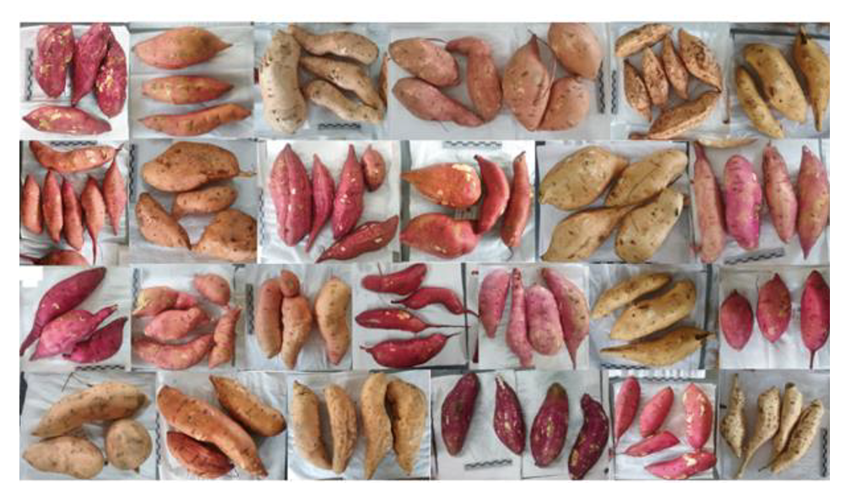

Inter-connected hexaploid sweetpotato families
SweetGAINS and GT4SP project: Dr. Hugo Campos (CIP) and Dr. Craig Yencho (NCSU)
Parents: Beauregard, Tanzania and New Kawogo
Genotyping: GBS using GBSpoly
Population: 723 individuals
Phenotypes:
Beta-carotene (↑Br, ↓Tz, ↓NK)
Dry Matter (↓Br, ↑Tz, ↑NK)
Starch (↓Br, ↑Tz, ↑NK)
Mollinari et al. (2020)

Slide 3
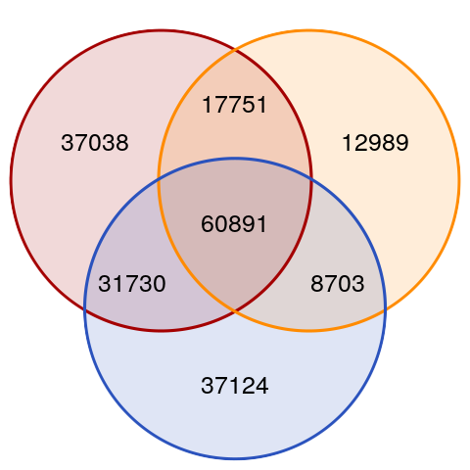
Variant discovery and dosage calling
Variant discovery:
TASSEL4-Poly, considering all the 728 individuals combined.
The genome of the diploid sweetpotato Ipomea trifida was used in the variant discovery process
Dosage Calling
SuperMASSA within each full-sib family
Probabilistic dosage calling
Minimum read depth = 20
Data points were considered missing if the maximum prob < 0.8
BT
TB
Population | Simplex P1 | Simplex P2 | Double Simplex | Multiplex | Total
BT | 29.4k | 44.8k | 15.8k | 57.4k | 147.4k
TB | 30.9k | 29.1k | 9.6k | 30.8k | 100.4k
NKB | 35.3k | 41.3k | 16.5k | 45.2k | 138.3k
NKB
206.2k

Slide 4
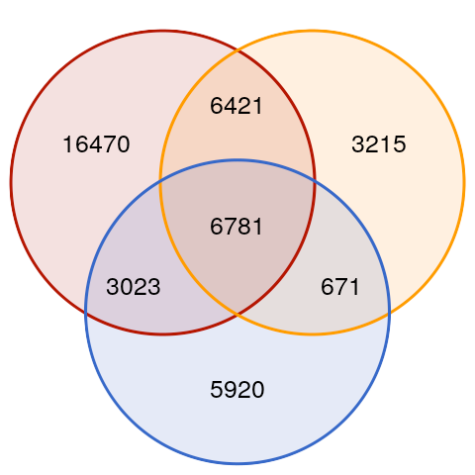
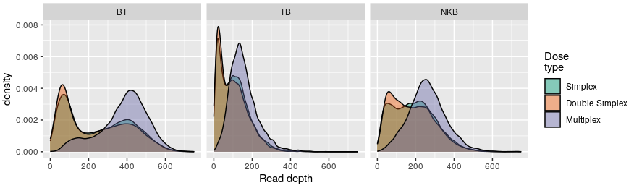
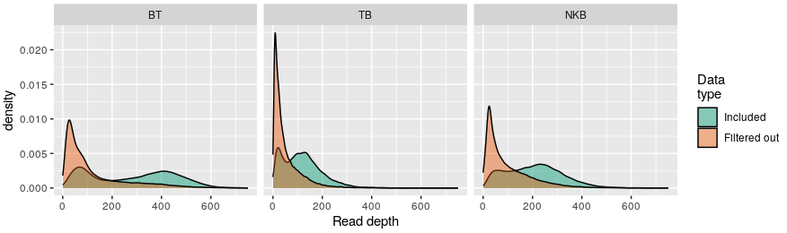
Quality control and data filtering
42.5k
BT
TB
Population | Simplex P1 | Simplex P2 | Double Simplex | Multiplex | Total
BT | 8.0k | 9.5k | 5.9k | 9.3k | 32.7k
TB | 6.0k | 5.8k | 1.7k | 3.6k | 17.1k
NKB | 3.6k | 5.7k | 2.2k | 9.9k | 16.4k
Average read depth and dosage type
NKB
Missing data
Markers: 20-25%
Individual: 18-22% - 702 ind.
Segregation: Bonferroni

Slide 5
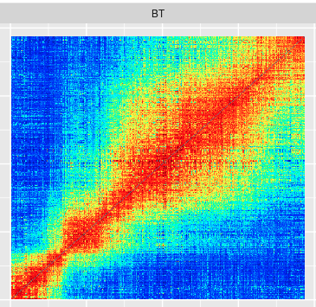
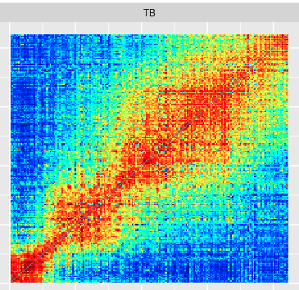
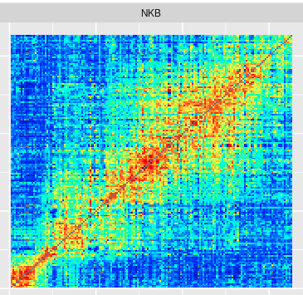
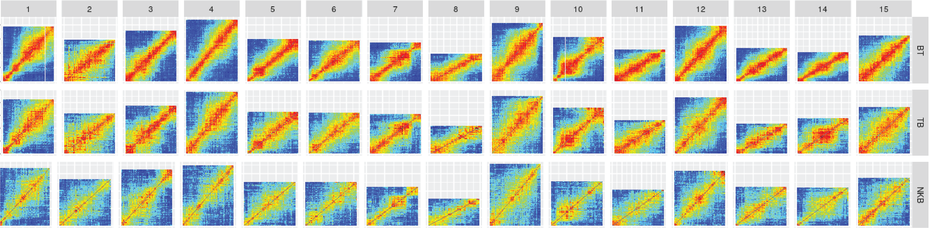
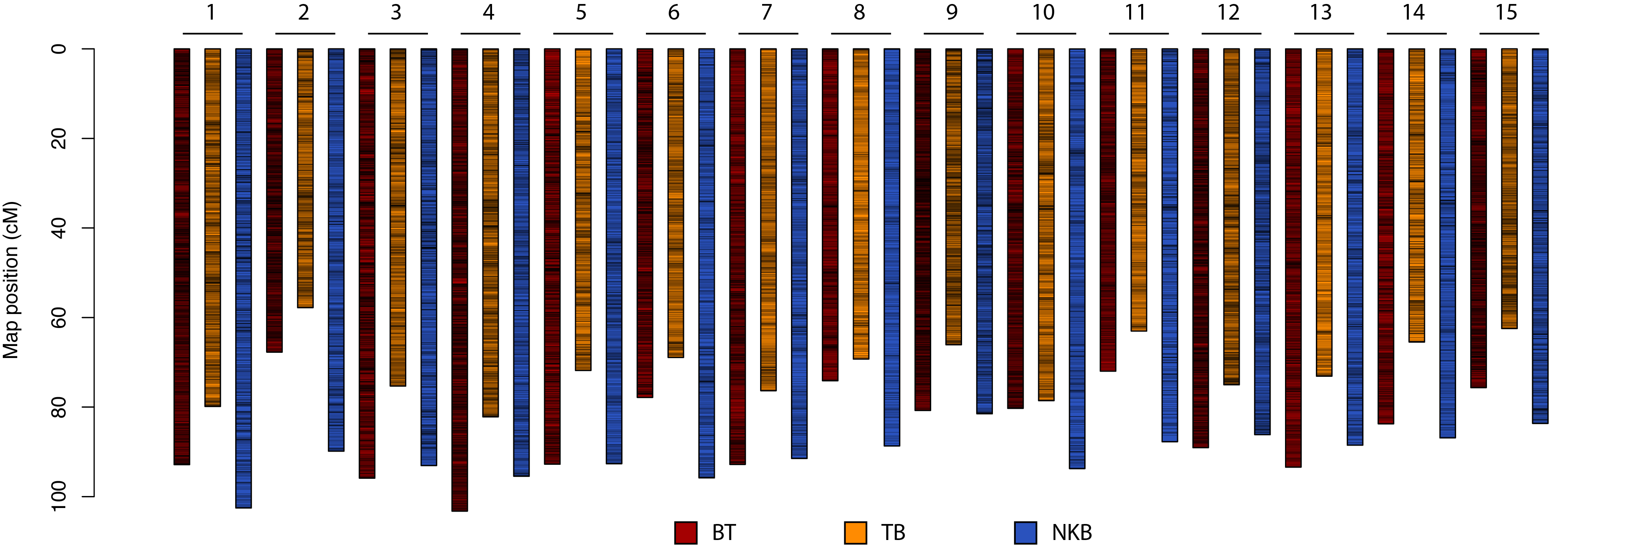
Construction of full-sib maps
Use of published BT map and I. trifida genome to order markers
Pairwise recombination fraction within chromosomes
Phasing using MAPpoly sequential algorithm
Population | # Markers | Map Length (cM)
BT | 22.5k | 1272
TB | 12.5k | 1065
NKB | 8.7k | 1357

Slide 6
Connecting multiple maps
Order
Use of published BT map and I. trifida genome to order markers
Other options
LPmerge: merge maps using linear programming (Endelman and Plomion, 2014).
MDS using consensus two-point recombination fraction (available soon)
Phasing
Merge maps using MAPpoly results
Assess homolog correspondence
Inconsistent markers were filtered out
Other options
PolyOrigin for diploids and tetraploids

Slide 7
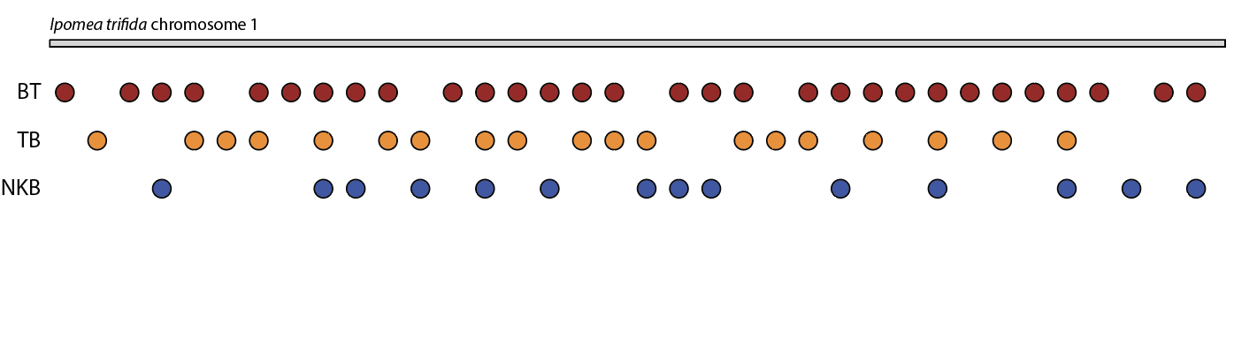
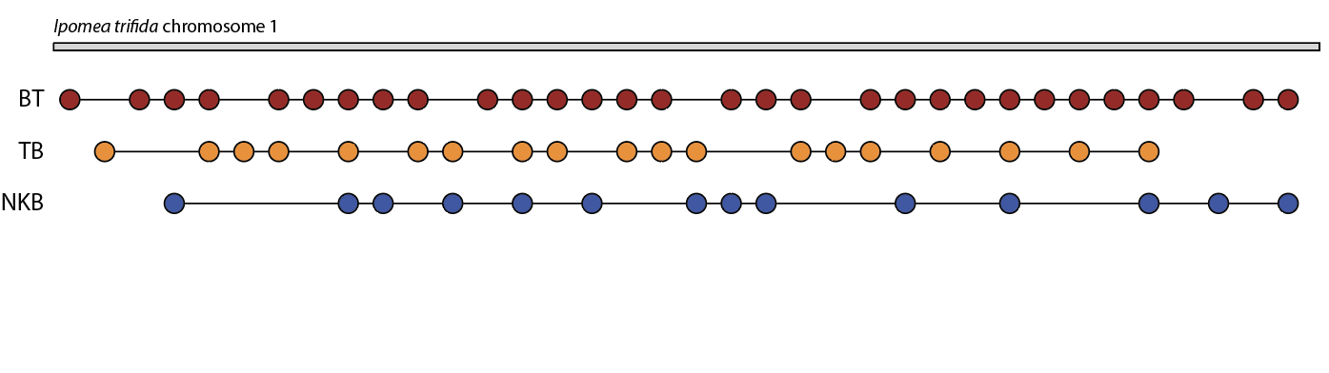
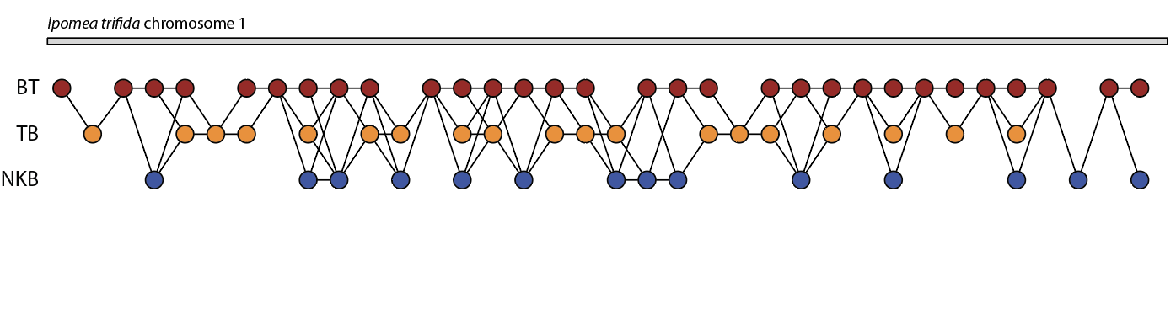
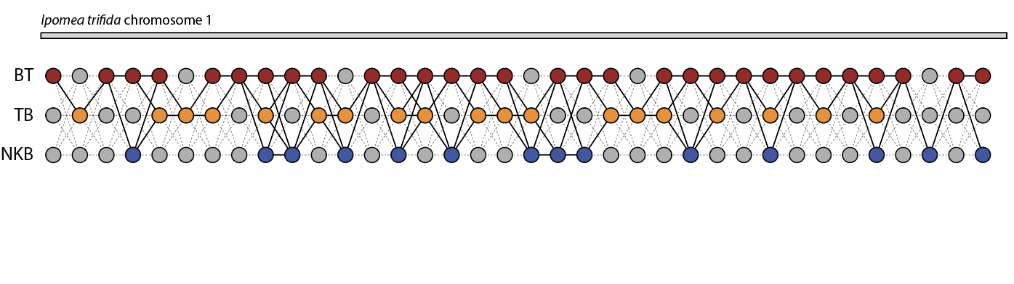
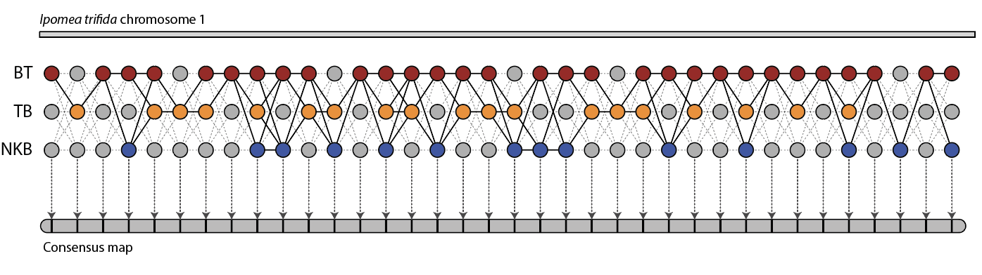

HMM and propagation of information in multiple maps
Mollinari and Garcia (2019)

Slide 8
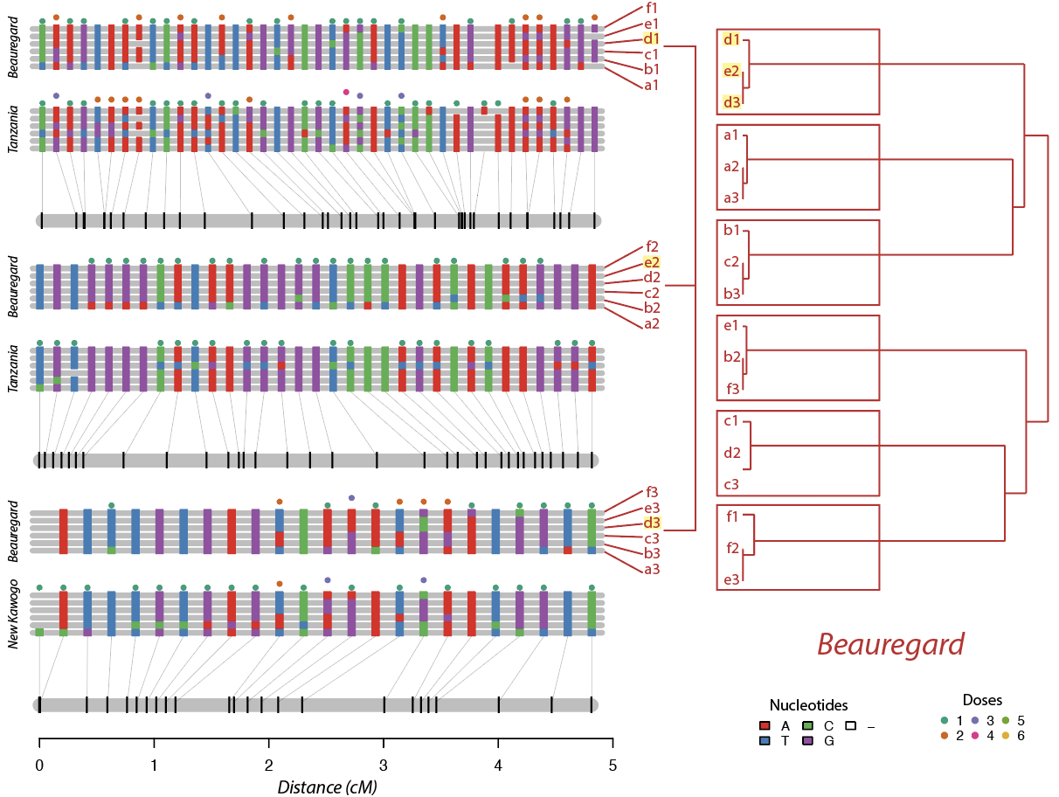
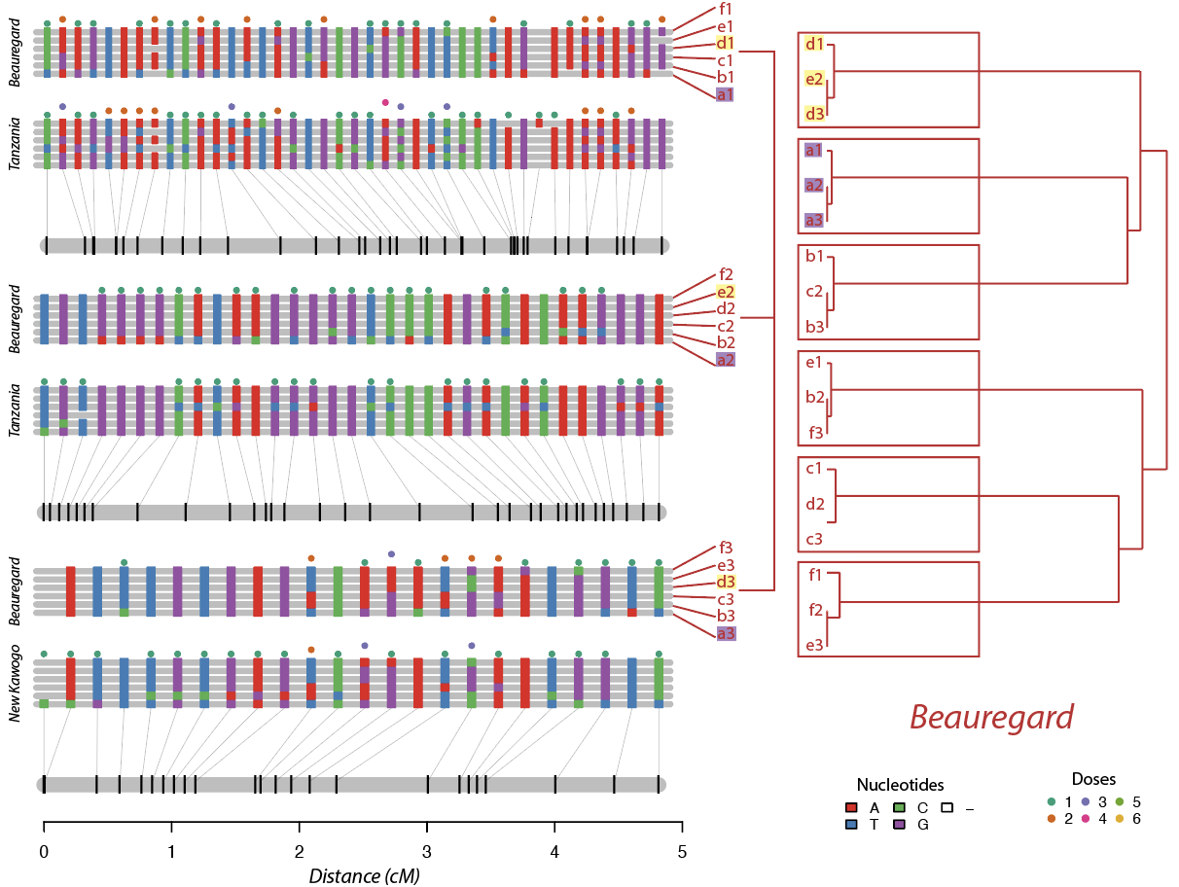
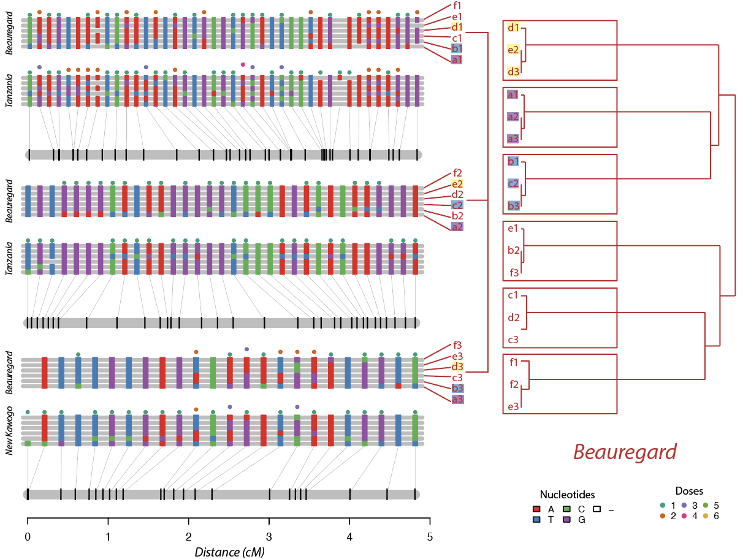
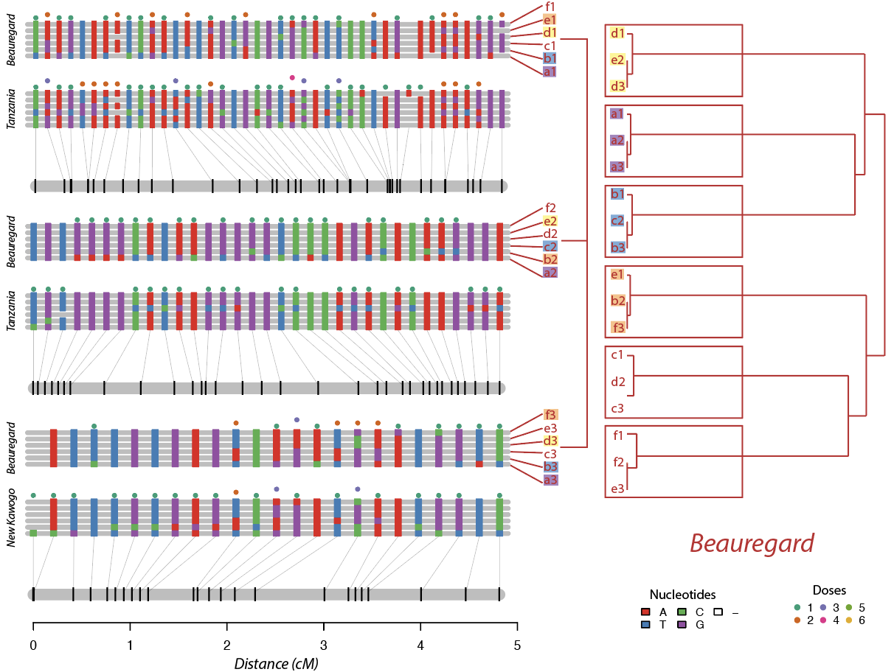
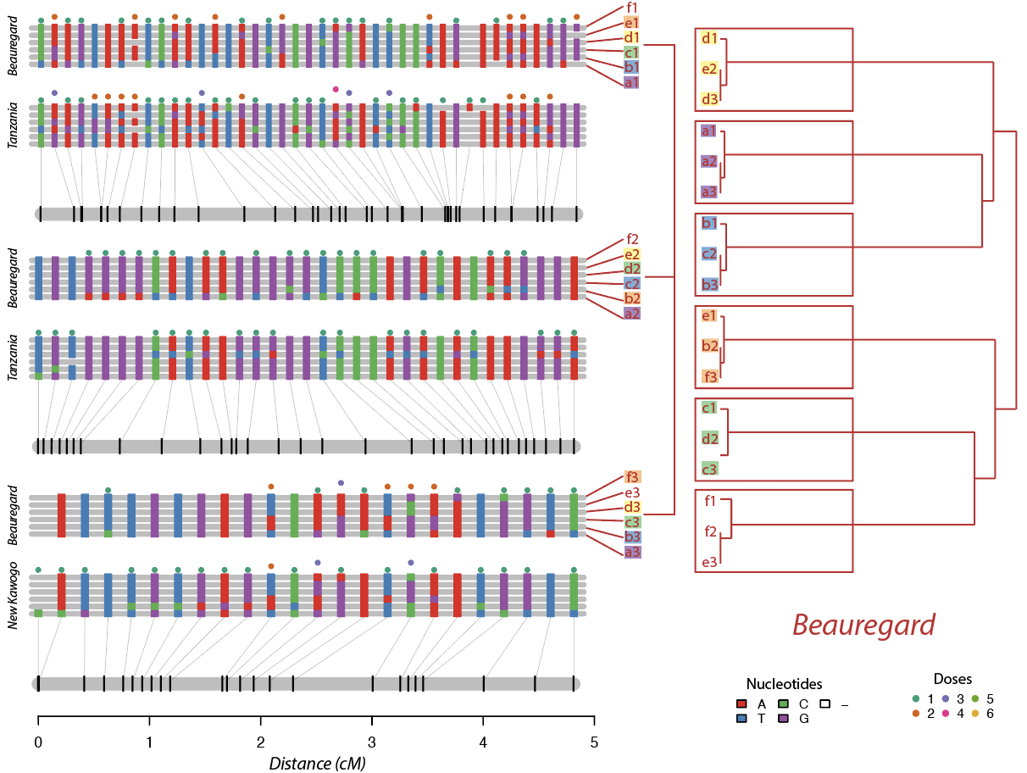
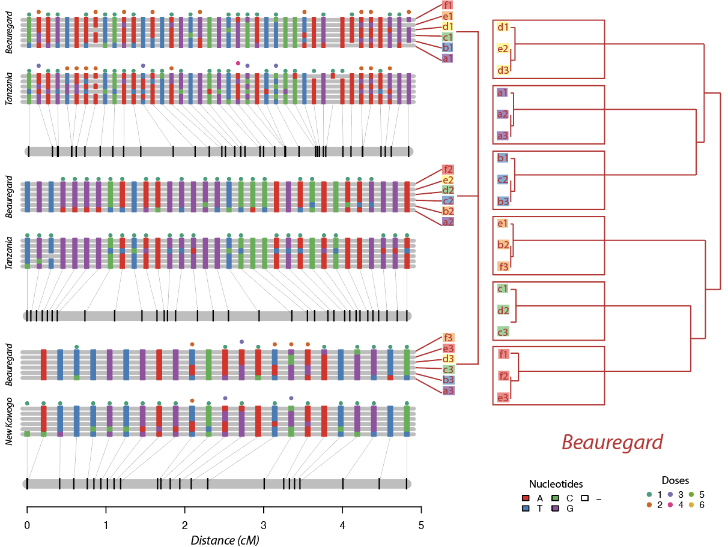
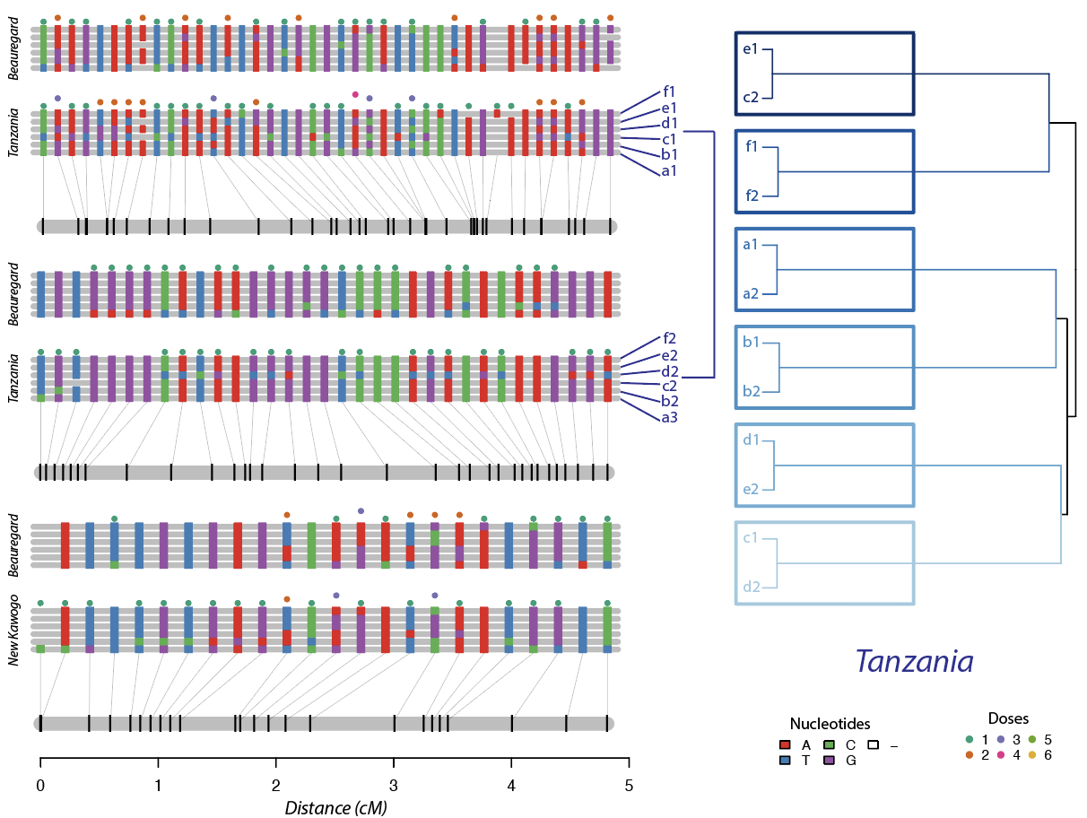
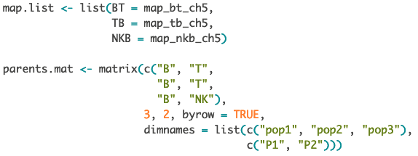
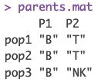
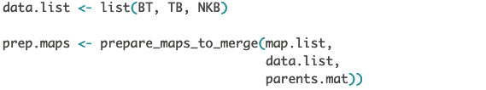
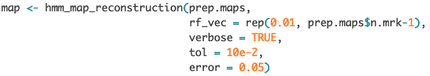
Prepare maps to merge
MAPpoly code

Slide 9
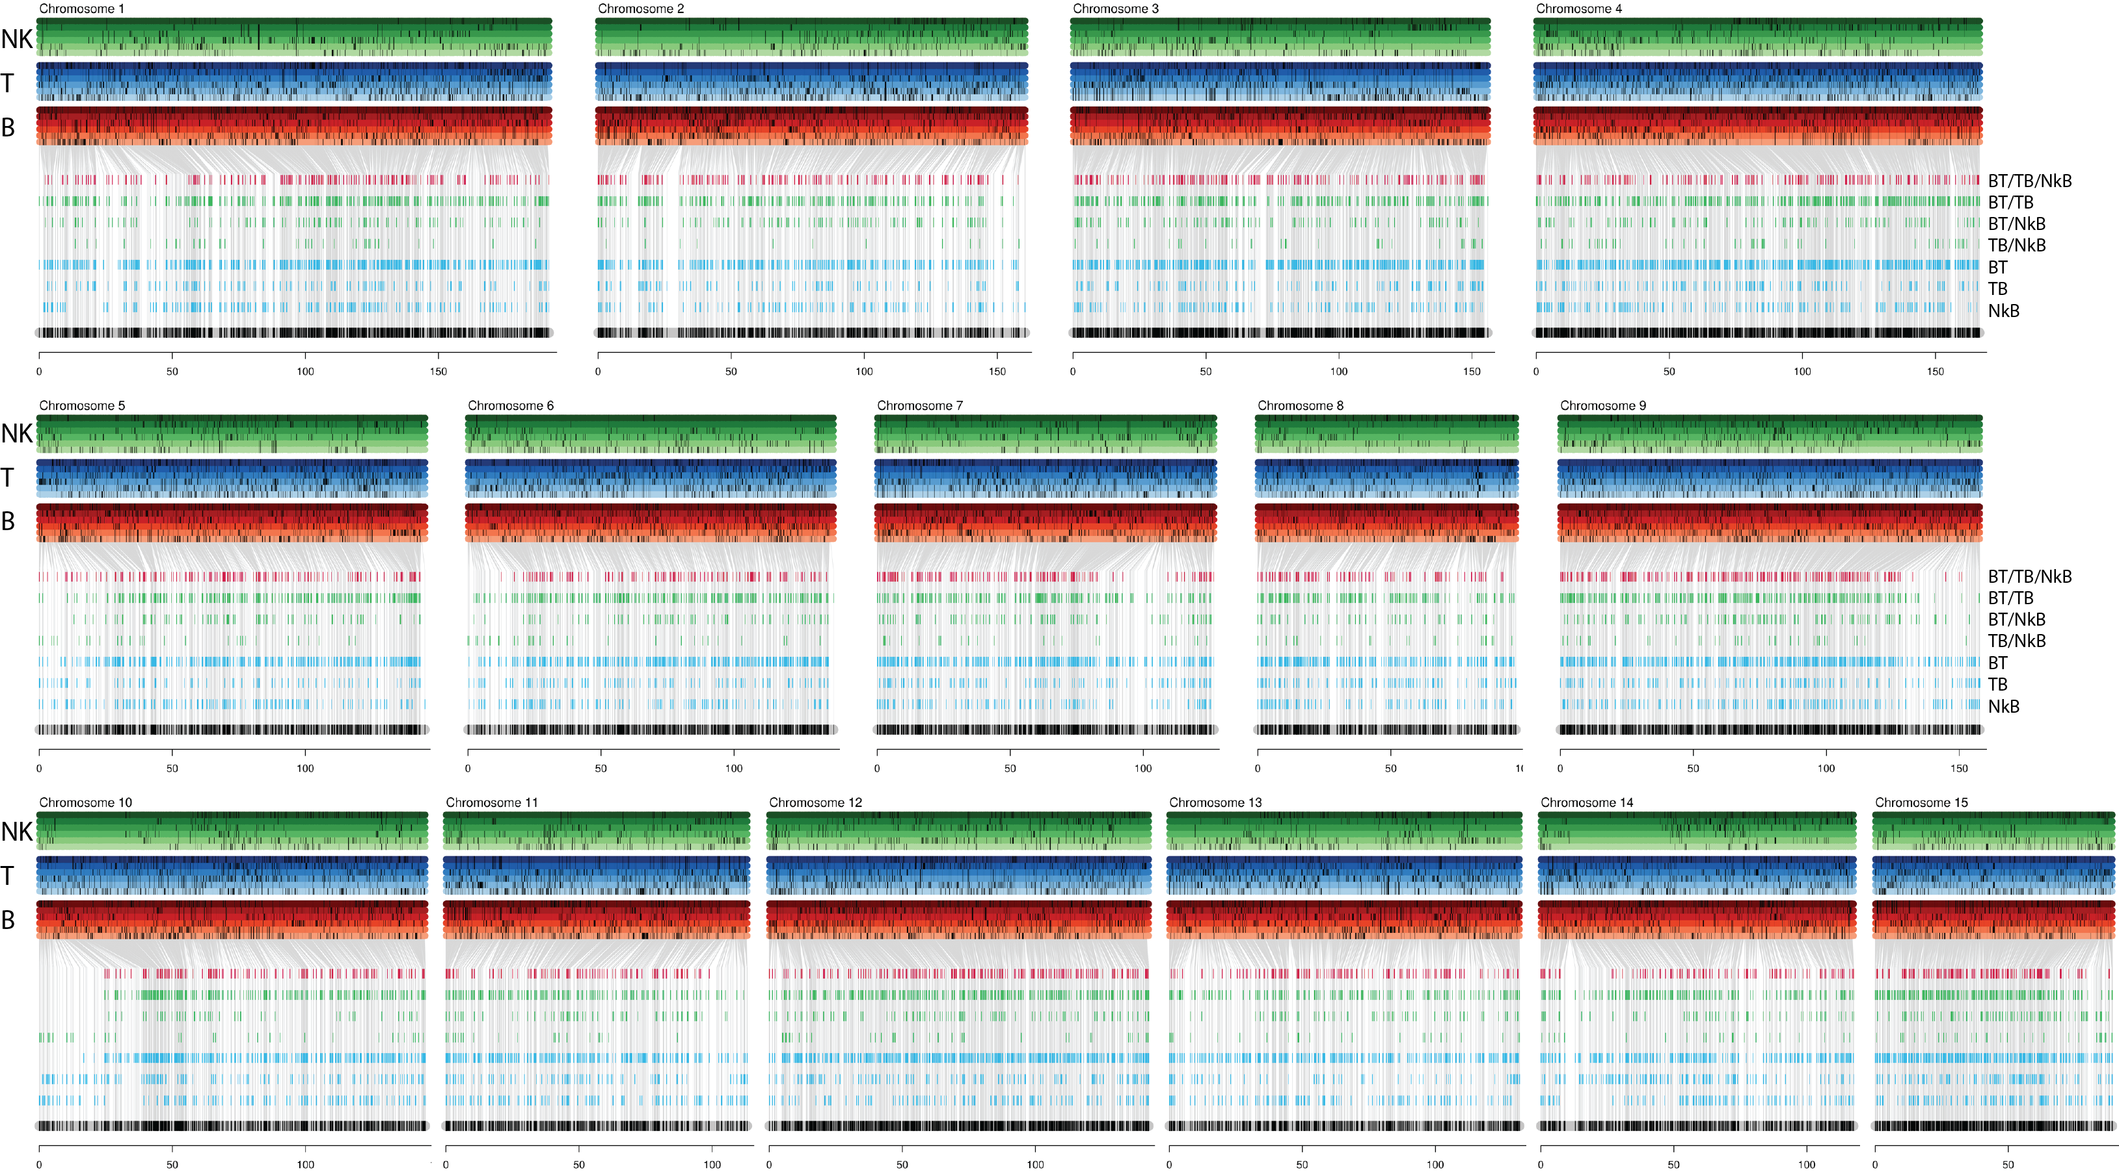
BT-TB-NKB genetic linkage map

Slide 10
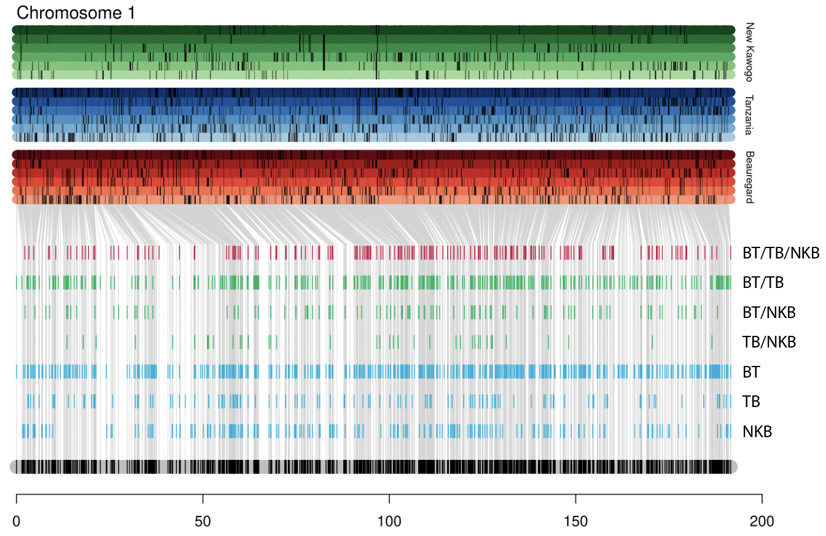
Consensus map
LG | Map length (cM) | Markers/cM | N. Markers | Max. Gap
1 | 191.6 | 12.6 | 2420 | 2.8
2 | 160.4 | 11.0 | 1759 | 4.4
3 | 155.9 | 13.9 | 2163 | 2.5
4 | 166.6 | 15.5 | 2589 | 1.6
5 | 145.0 | 12.6 | 1824 | 1.9
6 | 137.4 | 12.9 | 1771 | 1.9
7 | 126.6 | 13.1 | 1656 | 2.7
8 | 97.0 | 12.5 | 1216 | 2.8
9 | 157.7 | 15.4 | 2432 | 1.9
10 | 145.0 | 12.6 | 1831 | 2.7
11 | 113.1 | 12.5 | 1412 | 2.9
12 | 142.6 | 16.1 | 2299 | 1.8
13 | 131.7 | 11.2 | 1479 | 2.2
14 | 117.6 | 12.0 | 1411 | 3.8
15 | 89.1 | 22.0 | 1958 | 1.4
Total | 2077.1 | 13.7 | 28220 | 2.5
Population | # Markers
BT | 22.5k
TB | 12.5k
NKB | 8.7k

Slide 11
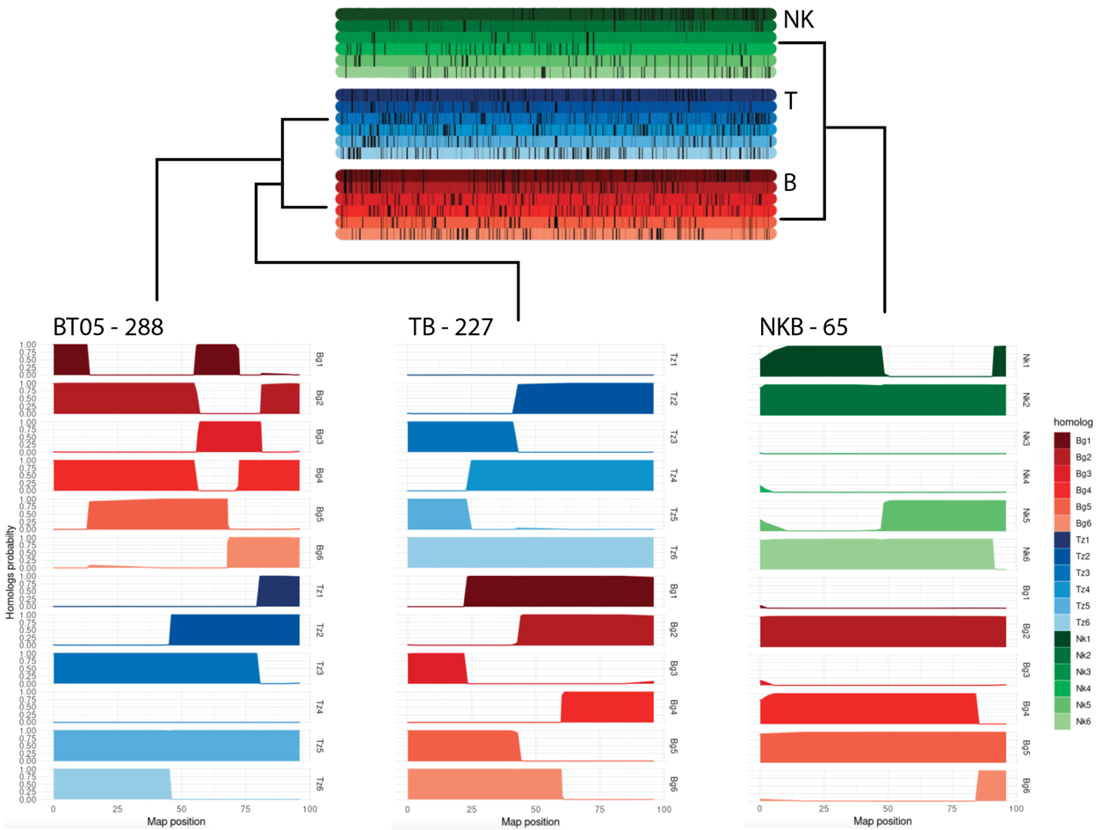
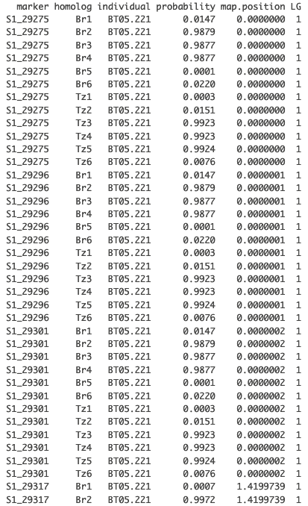
Haplotype probabilities in BT-TB-NKB

Slide 12
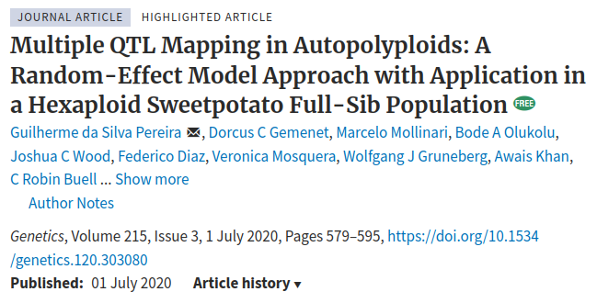
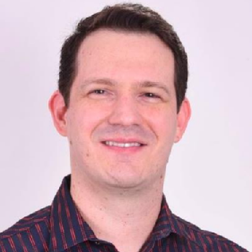
QTL mapping in interconnected families
Strategy based on the Random-Effect Multiple Interval Mapping (REMIM), proposed by Pereira et al. (2020)

Slide 13
QTL mapping in interconnected families
Performs multiple QTL mapping in polyploids
Includes both fixed and random-effect approaches
Supports phenotype weights (stagewise analysis)
Available on CRAN: https://cran.r-project.org/package=qtlpoly
Tutorials: https://gabrielgesteira.github.io/QTLpoly/
New features coming:
Support for single-step analysis
Multi-trait/multi-environment models
Support for multiparental populations

Slide 14
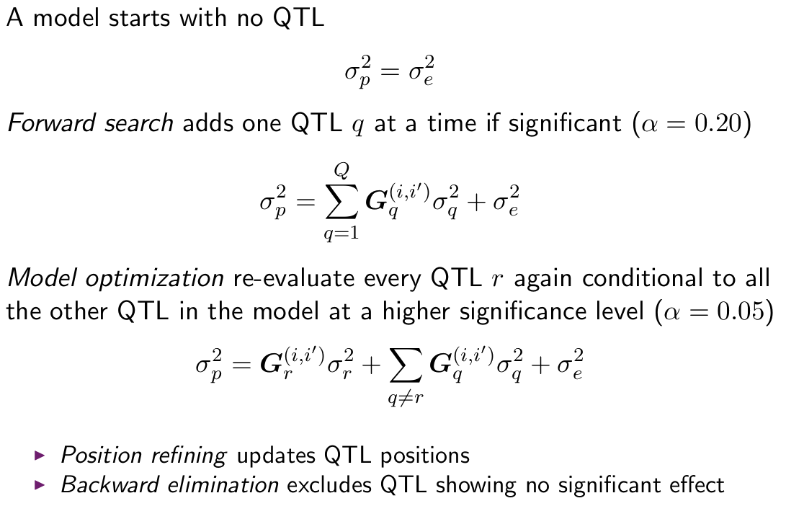
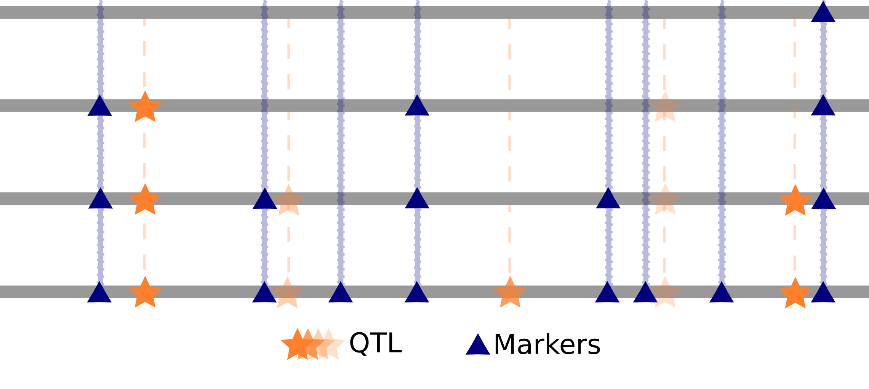
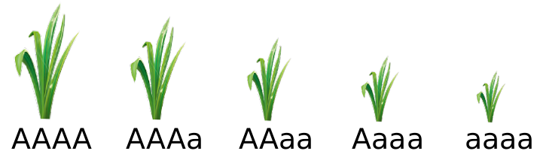
QTL mapping in interconnected families
Multiple QTL Mapping strategy:

Slide 15
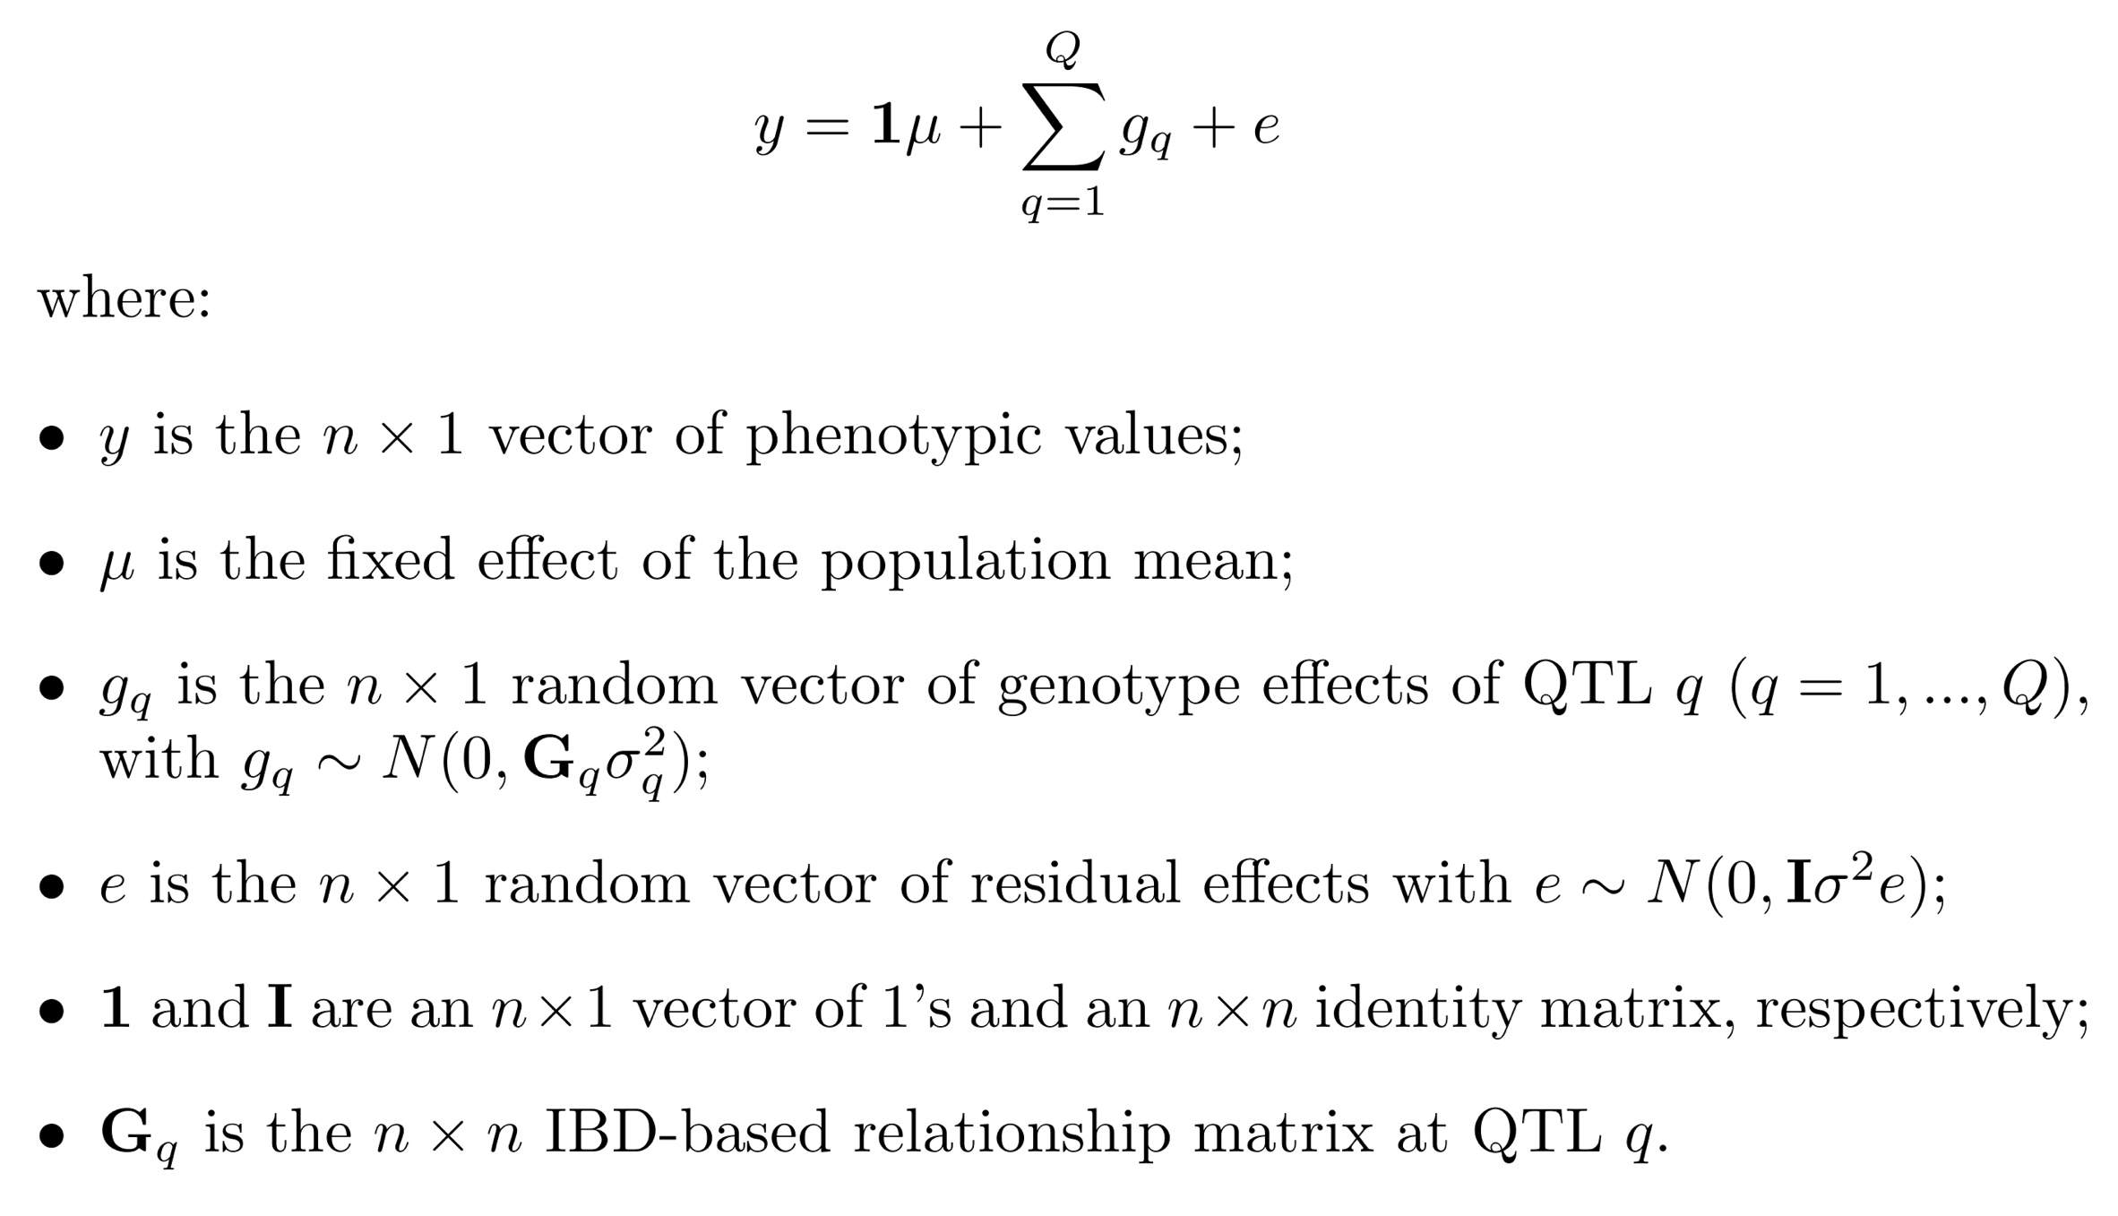
QTL mapping in interconnected families
Genetic model for a single-family/population:

Slide 16
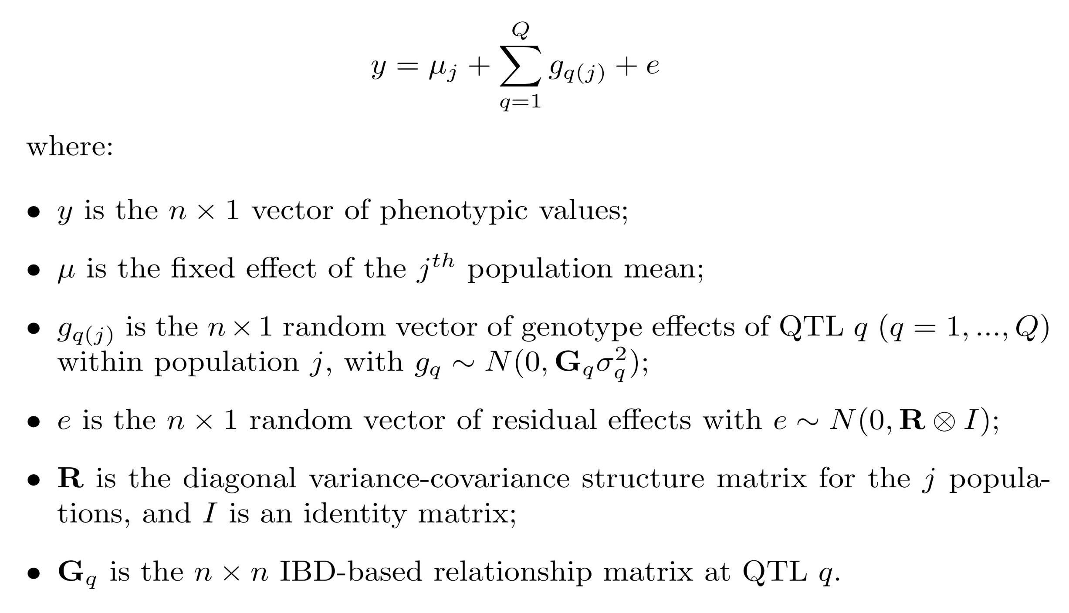
QTL mapping in interconnected families
Genetic model for the whole population:

Slide 17
QTL mapping in interconnected families
Strategy for interconnected families:
Perform QTL mapping within families
Perform joint QTL mapping in the whole population
Evaluate QTL consistency across families

Slide 18
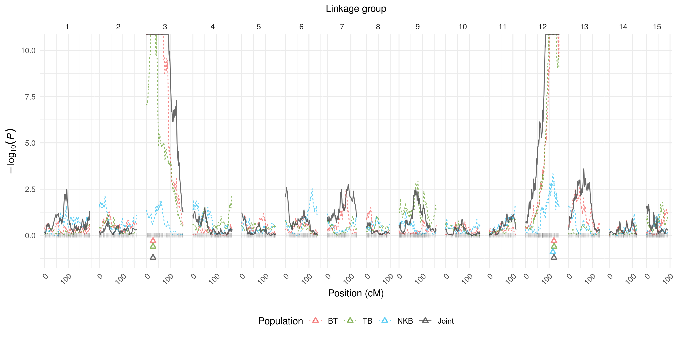
QTL mapping in interconnected families
Beta-carotene:

Slide 19
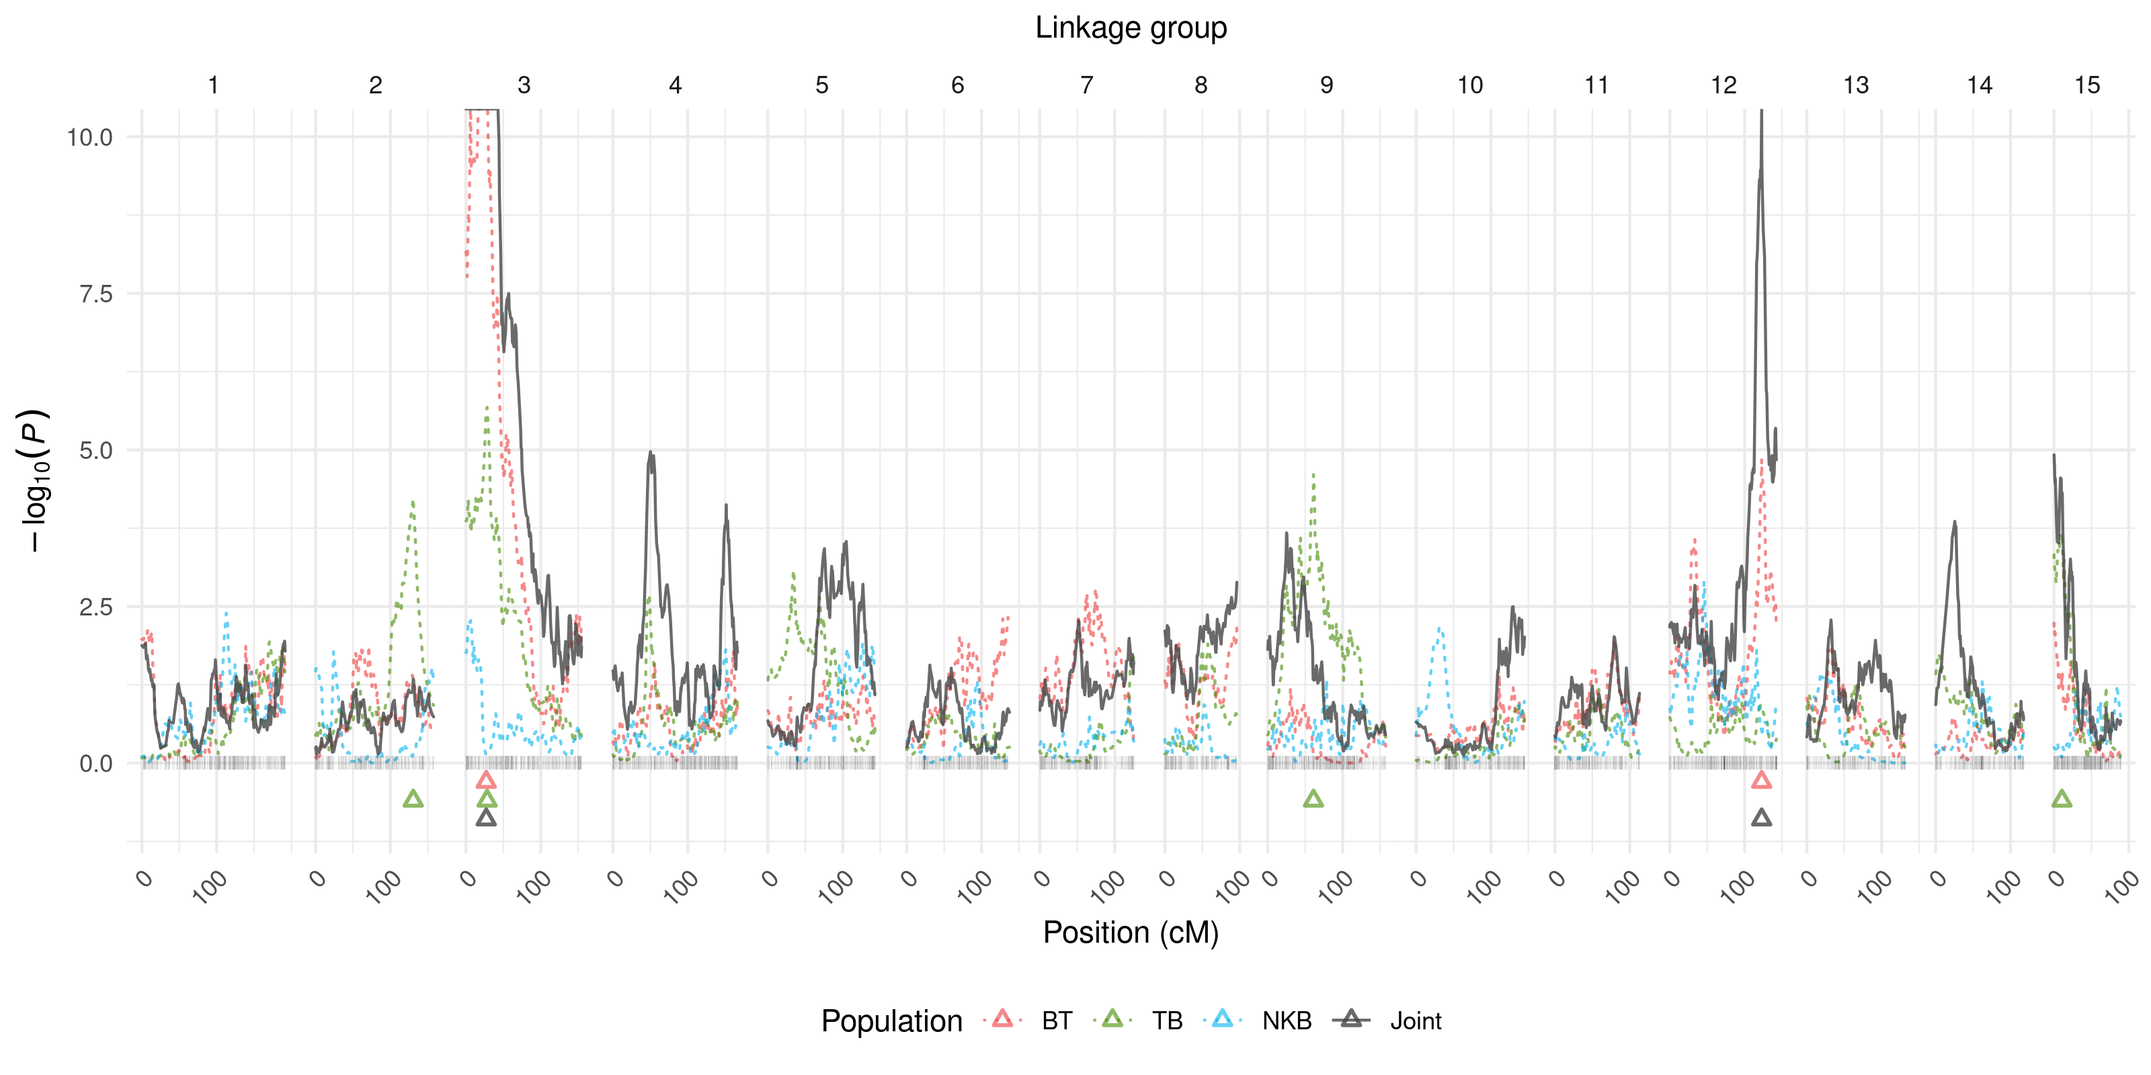
QTL mapping in interconnected families
Dry matter:

Slide 20
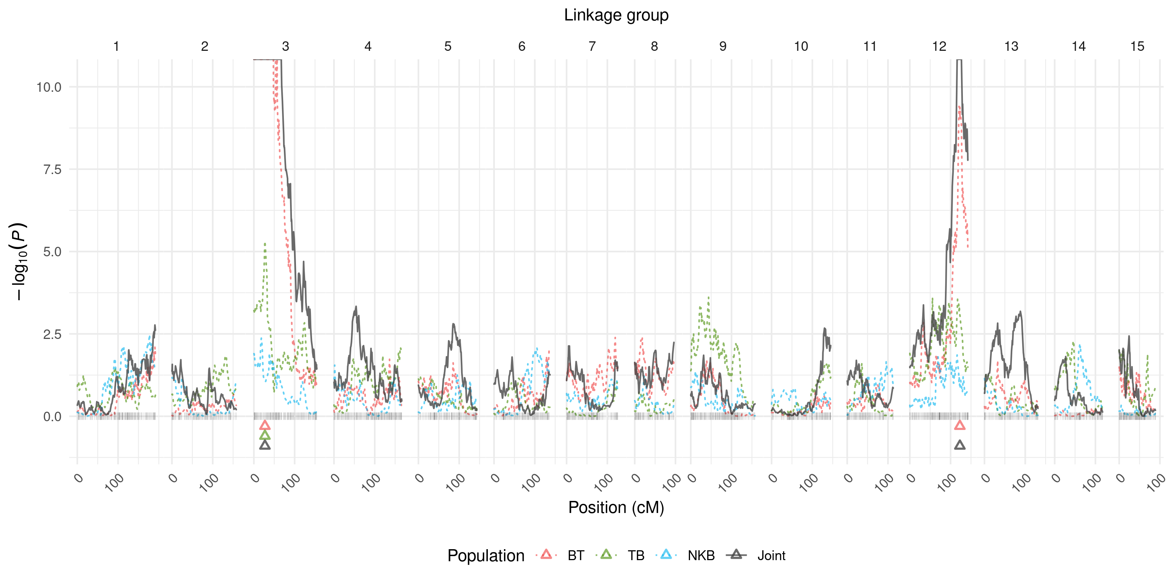
QTL mapping in interconnected families
Starch:

Slide 21
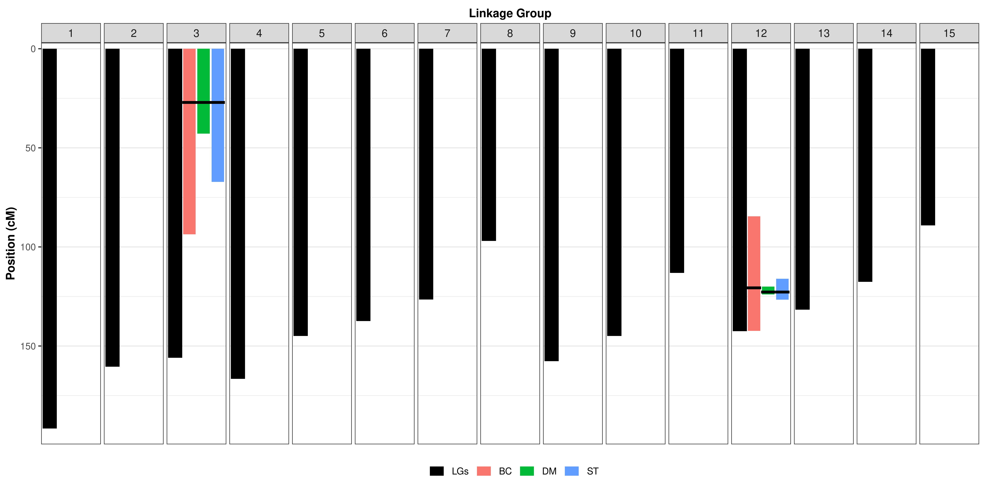
QTL mapping in interconnected families
QTL support intervals:

Slide 22
QTL mapping in interconnected families
Summary statistics
Trait | Intercept |  |  | Residual
 | BT | TB | NKB | BT | TB | NKB
BC | 19.84 | 16.71 | 12.35 | 157.32 | 225.66 | 13.50
DM | 27.39 | 26.94 | 29.11 | 4.36 | 4.14 | 1.10
ST | 62.61 | 59.64 | 68.68 | 14.25 | 13.08 | 8.19
Trait | QTL 1 |  |  | QTL 2
 | BT | TB | NKB | BT | TB | NKB
BC | 57.81 | 72.39 | 0.09 | 29.09 | 44.81 | 0.42
DM | 0.55 | 0.27 | 0.00 | 0.16 | 0.11 | 0.00
ST | 3.42 | 1.16 | 0.10 | 1.07 | 0.49 | 0.07
Heritabilities
Trait | BC |  |  | DM |  |  | ST
 | QTL 1 | QTL 2 | h2 | QTL 1 | QTL 2 | h2 | QTL 1 | QTL 2 | h2
BT | 0.24 | 0.12 | 0.36 | 0.11 | 0.03 | 0.14 | 0.18 | 0.06 | 0.24
TB | 0.21 | 0.13 | 0.34 | 0.06 | 0.03 | 0.09 | 0.08 | 0.03 | 0.11
NKB | 0.01 | 0.03 | 0.04 | 0.00 | 0.00 | 0.00 | 0.01 | 0.01 | 0.02
Trait correlation
 | DM | ST
BC | -0.57 | -0.57
DM |  | 0.83

Slide 23
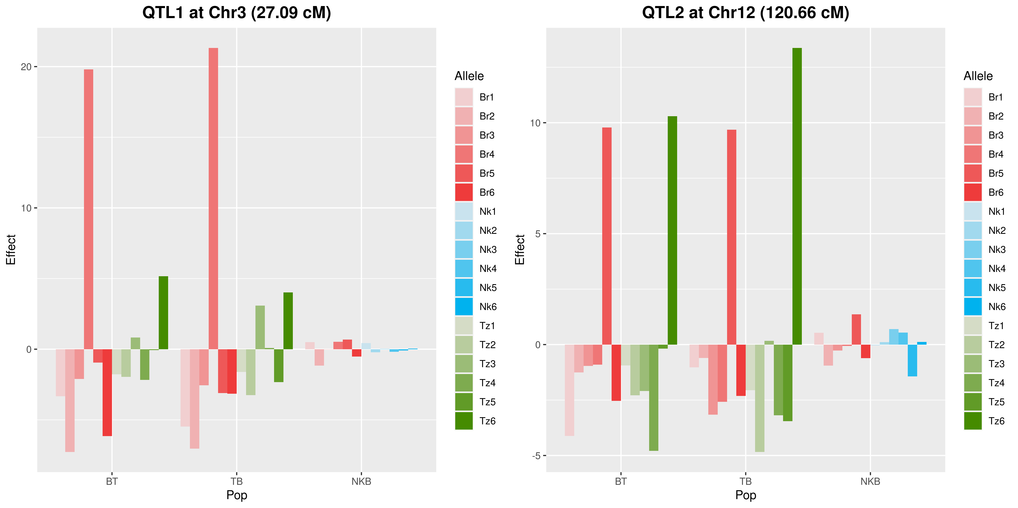
QTL mapping in interconnected families
Allele effects for beta-carotene:

Slide 24
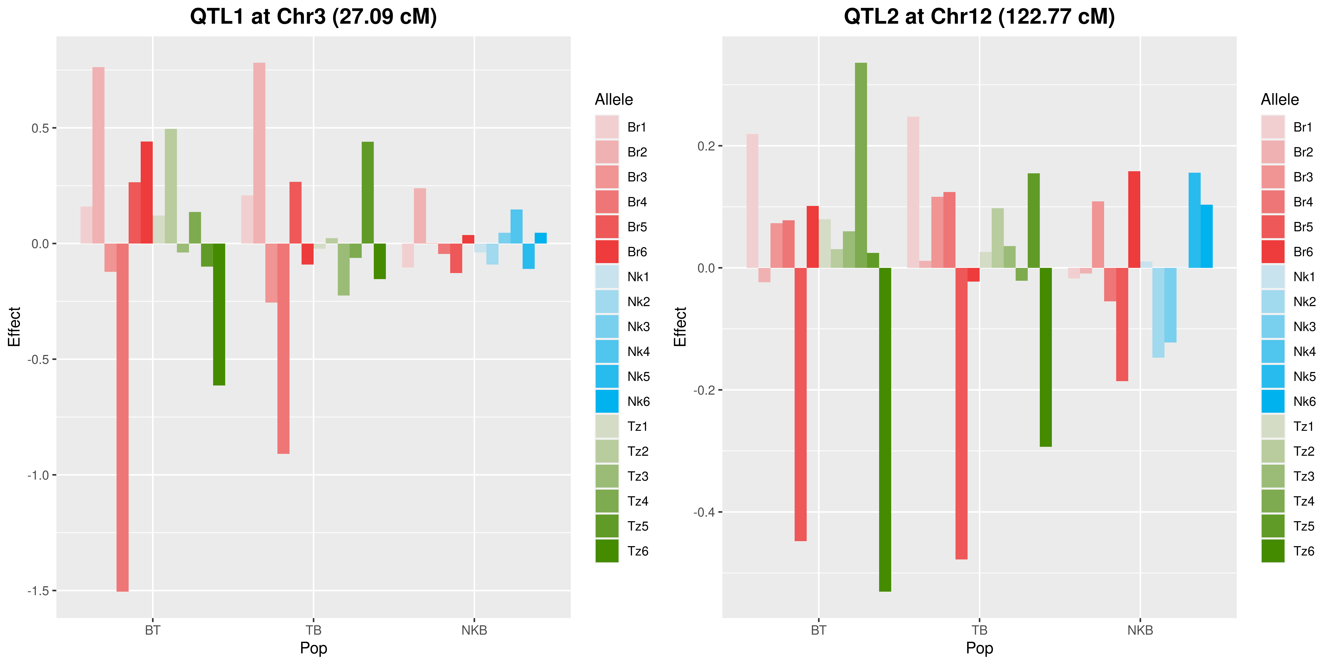
QTL mapping in interconnected families
Allele effects for dry matter:

Slide 25

QTL mapping in interconnected families
Allele effects for starch:

Slide 26
Perspectives for the upcoming year
Next steps on the MAPpoly development:
Mixed ploidy levels: all combinations among ploidy levels 2, 4, and 6
Allow multiallelic markers: Any level of information from biallelic to completely informative
More complex population structures
Next steps on the QTLpoly development:
Support for single-step models
Multi-trait and multi-environment QTL analysis
Improvements in the computing efficiency

Slide 27
Assistant Professor – Vegetable molecular breeding for sustainable production (Department of Horticultural Science - NCSU)
The Department of Horticulture Sciences in the College of Agriculture and Life Sciences at North Carolina State University is pleased to announce recruitment for a tenure-track Assistant Professor with formal appointments in research (80%) and teaching (20%).
More information at https://jobs.ncsu.edu/postings/172089

Slide 28












Project Members

Slide 29






















Other Collaborators
Neuhouse Farms
Woolf Roses L.L.C.

